Slide 1
Tutor Agent Presentation
Yason Khaburzaniya
&
Ermolay Beketov

Slide 2
AI Agents for Personalized Learning & Tutoring
The user reads study guides generated by LLMs and then answer questions to increase their proficiency level for each topic.
After reading the study guide generated based on a book in the database, the user will gain access to quiz questions generated based on the study guide
To keep quizzes from being boring, we implemented difficulty levels.
LLM decides when the user is ready to go the next level as the user is answer questions one by one
Decided to show quiz questions one at a time to keep the user engage and not feeling overwhelmed by many questions.
The study progress summary is asynchronously updated by another agent
The study guides are then asynchronously updated based on the the study progress summary
For user convenience all the same features work if the user wants to listen to a podcast style study guide. The user can switch between podcast styles

Slide 3
Technical Architecture
We are using 2 agents that maintain state(In memory, later in DB).
The Study Guide Supervisor keeps all the state
The Study Progress supervisor maintains a similar mapping, but fewer fields
Both support multiple users where each user is assigned a different thread
1 agent that doesn’t maintain state gets detailed parameters and uses tools to generate study guides
The study guide generating agent also integrates with a SQL database to pull book chapters from a database(populated from a free book text found online)
After experimenting with google and openai models, decided to use gpt-4o
gpt-4o-mini for speed
Using LangGraph checkpointer to store agent state and support multiple users
Using Kafka and a PubSub mechanism similar to Google PubSub for asynchronous messaging between agents.

Slide 4
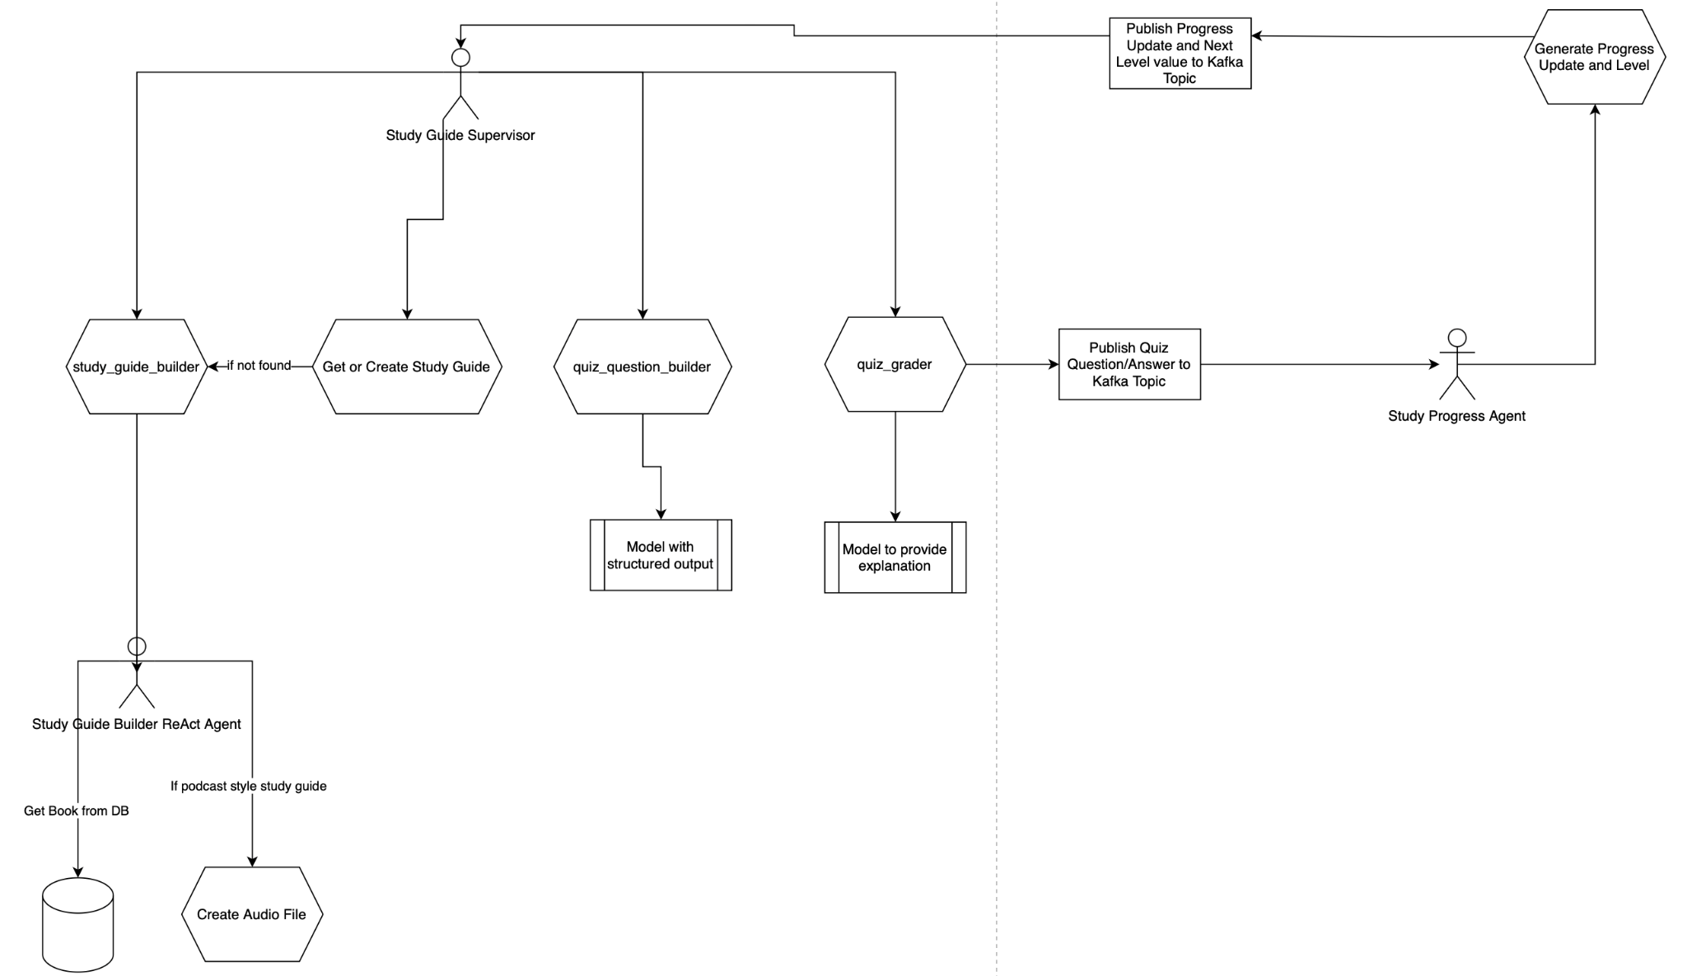
Technical Architecture

Slide 5
Demo
Will Generate Video later

Slide 6
Challenges/Learnings
Learned that some models do not support supervisor multi-agent design
Struggled with gemini models until gpt-4o made thing a lot easier
Good understanding of data model is key, otherwise have to replumb the data at every step
Can use agent checkpointer and store entire agent state into database.
Convenient, but not sure it is scalable
Working with Math Study guides from UI and correctness standpoint is very hard

Slide 7
Future Enhancements
Responsible AI
Improve citations. Right now citation is for the book used to generate study guide. Should really cite every sentence
Allow reporting of issues with the data
Reduce hallucinations by using embeddings models to verify that text generated by the AI is actually found in source material
Reduce hallucinations by having a swarm of agents check each sentence/paragraph for having bases in the source material
UI
Short focused study guide to dwell into weak areas
Interacting with the study guide to get explanations of selected text
Text interactions with study guide to allow regeneration, or live updates
Streaming of study guide text to the page to allow seeing text as soon as possible
Make audio player better and also allow shorter versions of focused study
Images in the study guide
Update cross subject/topic study guides (half done)
Make Quiz Question view more engaging and Level grades/downgrades more fun and logic more transparent
Data
Use mongoDB for a properly destructured data model
Store audio and image files in the cloud
Security
Proper Login
Secure Agent endpoints
Architecture
Improve agent interactions with more agents using PubSub (for example generating quiz questions asynchronously)
Audio
Update to generate podcast with two speakers

